Slide 1
PROJECT : AI POWERED SEARCH FOR CLOUD STORAGE TEAM DETAILS
NAME | REGISTER NUMBER | DEPARTMENT/YEAR
ANDRA GOVARDHAN NAIDU | 99220040239 | CSE/III YEAR
NANABALA PRAVALLIKA | 9823005009 | ECE/III YEAR

Slide 2

AI-Powered Smart File Search: Revolutionizing Cloud Storage
This system revolutionizes cloud storage. It uses AI for efficient file management. Users can upload, search, and retrieve files easily. The system indexes file content using NLP. This enables content-based searches beyond filenames.

Slide 3

Our Solution: AI-Driven Content Search and Indexing
Storing
Searching
Securely stores files in cloud storage. Supports various file formats (PDF, DOCX, TXT,VIDEO,AUDIO,WEBPAGES etc.).
Uses NLP to analyze file content. Enables semantic search capabilities.
Extracting
Indexing
Extracts text from files, regardless of format. Handles OCR for scanned documents.
Creates an index of extracted content. Allows for fast and accurate searches.

Slide 4
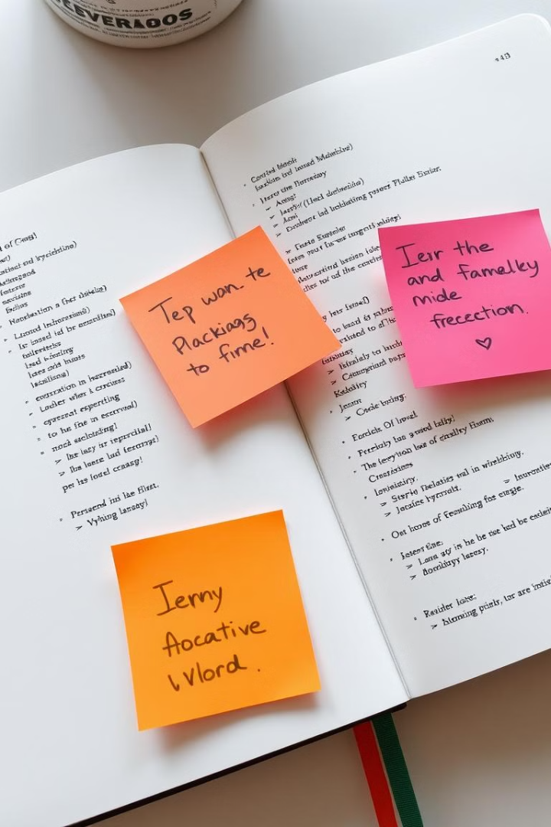



Key Technologies: NLP, Python, and Web Development Stack
NLP
Python
Web Stack
Natural Language Processing for content analysis.
Backend development and AI model integration.
HTML, CSS, JavaScript, PHP, SQL for the user interface and database,XAMPP.

Slide 5

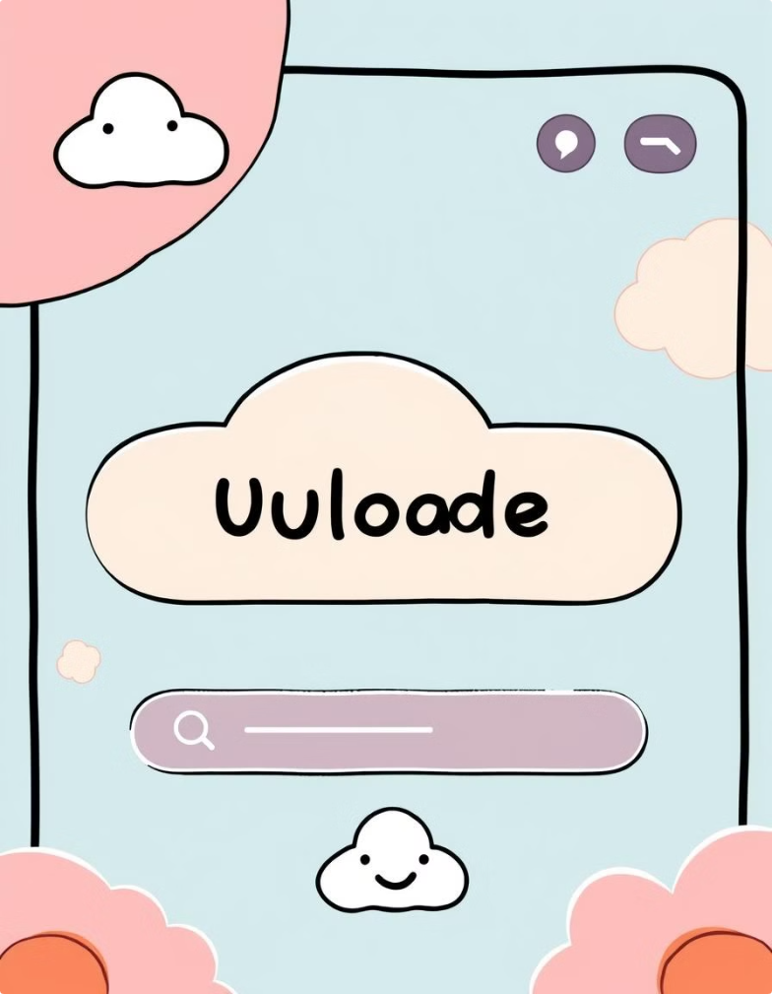




Core Features: Upload, Delete, Intelligent Search, and Retrieval
Upload
Drag-and-drop functionality for easy file uploads.
Delete
Secure file deletion with confirmation step.
Intelligent Search
Content-based search with NLP support.
Retrieval
Download files quickly and easily.

Slide 6

Use Case Demo: Finding Critical Information Instantly
1
User Uploads File
A user uploads a contract document.
2
AI Indexes Content
The system extracts and indexes contract terms.
3
User Searches
The user searches for "liability clause."
4
Instant Results
The system finds and highlights the relevant clause instantly.

Slide 7

Benefits: Enhanced Productivity and Data Accessibility
1
Time Savings
2
Improved Accuracy
Reduces time spent searching for files.
Finds relevant information within files.
3
Increased Productivity
Enables faster decision-making.

Slide 8



Real world Applications
Legal
Healthcare
Business
Quickly find relevant case law and legal documents.
Access patient records and medical research efficiently.
Locate market reports and internal documents instantly.

Slide 9
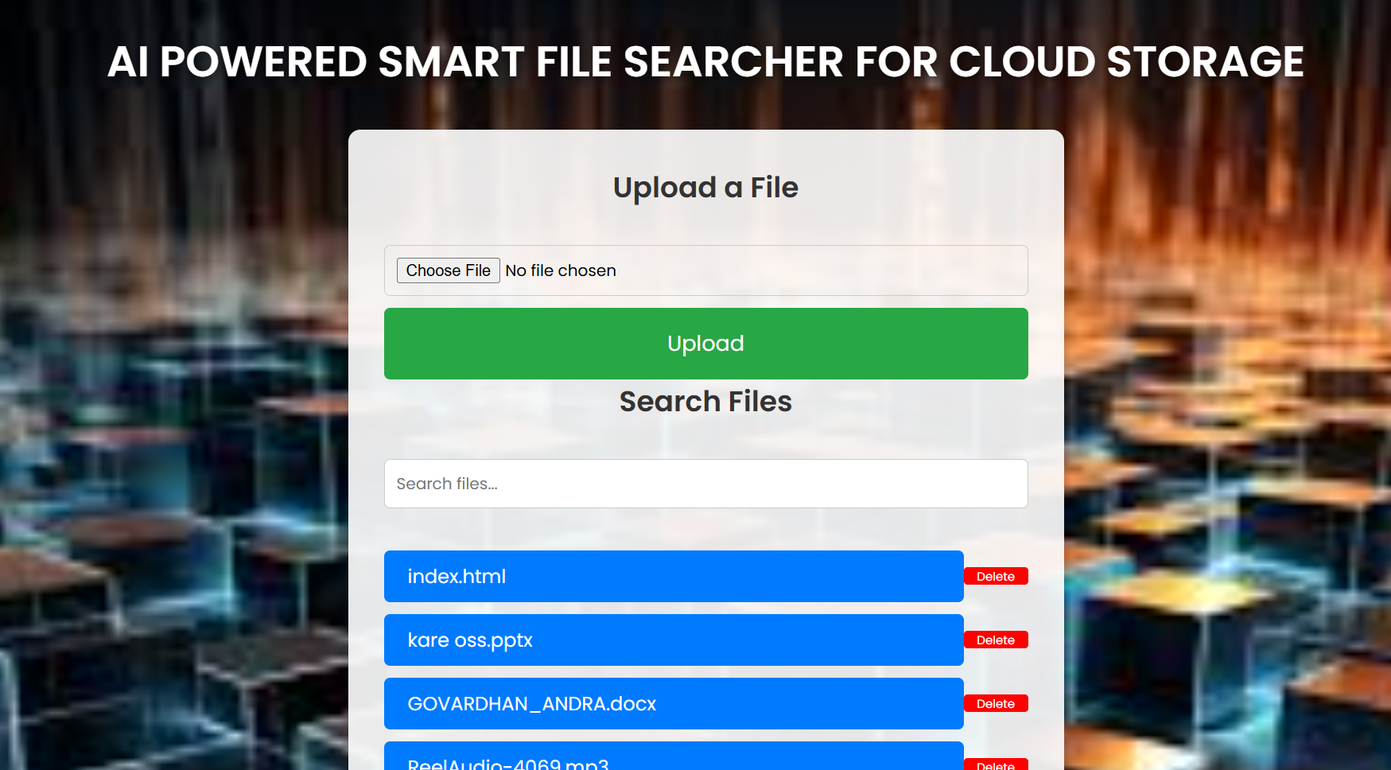
FINAL IMPLEMENTATION

